Slide 1

Navinna Ayurveda Hospital Case: Case Summary
Ayurveda, medicine that stems from religion and ritual, and Allopathy, Western medicine, are seen as alternate forms of medication in present day Sri Lanka
Founded in 1962, Navinna is largest Ayurveda hospital in Sri Lanka, encompassing 125 personnel.
This includes 31 doctors, 8 nurses, 15 ward attendants, 5 kitchen staff.
Mission: national leader of Ayurveda research
Goals: improve the contribution of Ayurvedic medicine to patient well-being
Services: In-house treatment, out-patient treatment, clinics
Staff:
Doctors: received specialized training in the practice of Ayurveda for at least 6 years
Nurses, Attendants, Pharmacists, etc: undergone special training on Ayurveda
Main problems:
Severe shortage of qualified staff.
Exorbitant wait times for patients, which leads to errors in processes by doctors and nurses, which could lead to a bad reputation.
Need for proper formalization, documentation of business processes

Slide 2
Main Goals of Process
Stakeholders
Guide and coordinate the actions of health care professionals
Tackle the constraints of limited physical, financial, and human resources.
Non-for-profit organization
In addition to patient care, the hospital also provides teaching and research programs.
Positive influence on national healthcare system.
Provide improved patient outcomes that are sustainable.
Facilitate establishment of a set of easily manageable metrics.
Patients and their legal guardians.
Hospital Employees
Doctors, Nurses, Ward Attendants, Kitchen Staff, etc.
The Ministry of Health and Indigenous Medicine of Sri Lanka.
Under the direct purview of the Department of Ayurveda.
Pharmacies and IDD
The entities that provide medication for these patients.
Researchers of Ayurvedic Medication

Slide 3
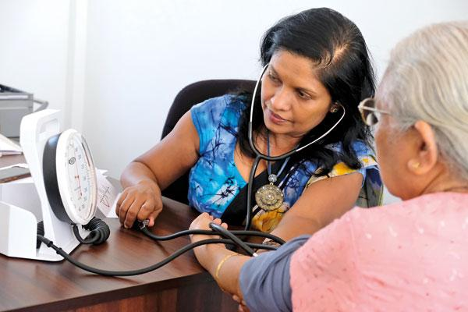
Strengths of current process
Strong understanding of core processes
Organized hierarchical structure
Experienced and well-trained medical care staffs
Daily check-up of patients from doctors/hospital staff
Registers/log books that store and organize information about capacity, patient’s information, and patient’s medications
Doctor checking patient’s condition
Notes:
Core processes: primary activities, support activity
Experienced medical care staff: all doctors have received specialized training in the practice of Ayurveda for at least 6 years. Other staffs (nurses, attendants…) are also well-trained.
I copy pasted my notes for slides 2 and 3 on them, we dont need to use them I thought I would just share regardless.

Slide 4
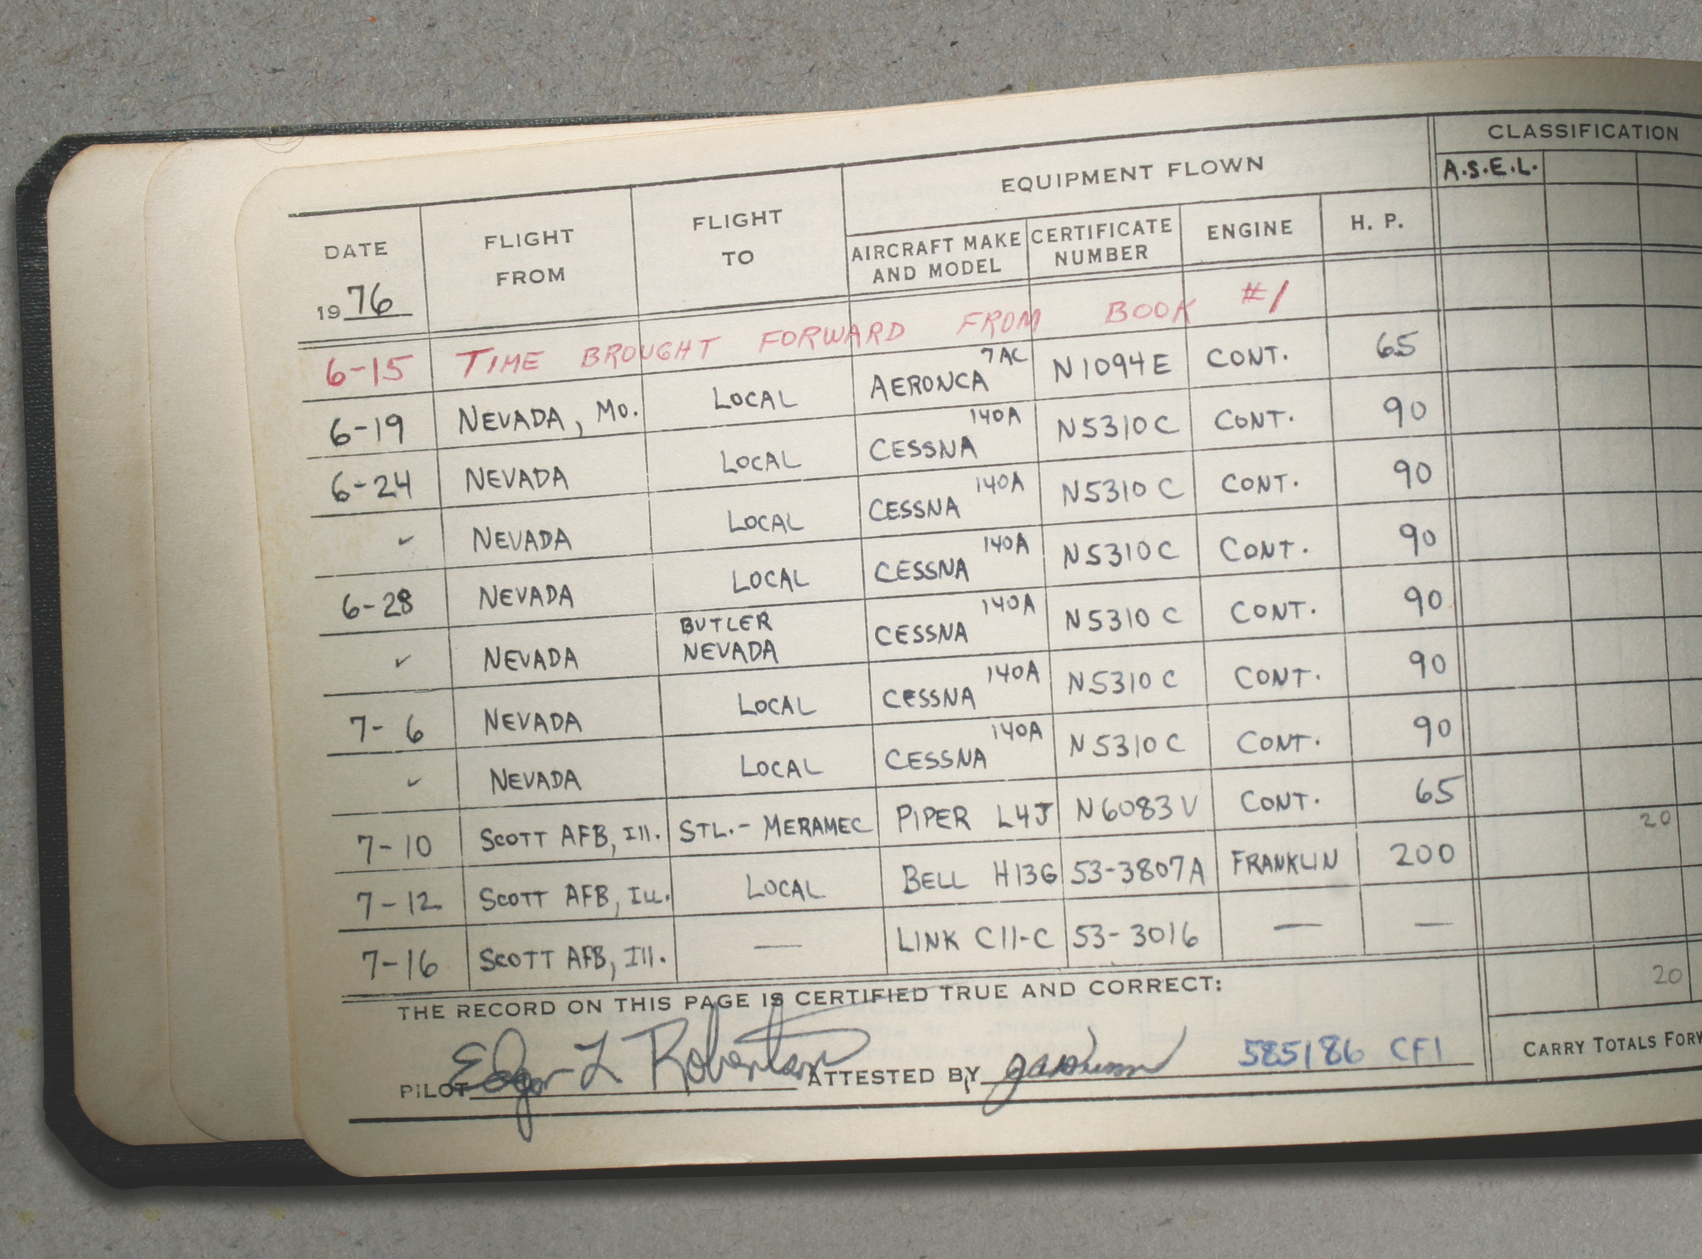
Weaknesses of Current Processes (Overall)
Patients have to self identify. Patient to find out when the doctor is available to treat them, and they have to be able to navigate the different departments within the hospital on their own.
Patient errors due to severe shortage of staff, especially with those patients who see multiple doctors or have multiple diseases
Complex patient care chain with disorganized structure
3 main types of variants: in house patients, outdoor patient, and clients
2 types of patients:
First time patients who are always directed to OPD
Repeat patients who can either be directed to OPD or clinics
Records maintained manually (ex: logbook of patient’s details, physical books of patient’s conditions, records prescription forms)
With the plethora of registries that each nurse and doctor have to keep recording, it can be inefficient.
Logbooks
Notes:
He probably wants some visuals
Sounds good can you fix case summary?? It looks messy
I can fix this slide with weaknesses

Slide 5
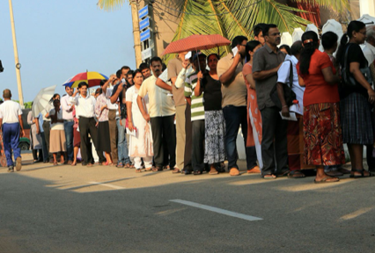
Friction Points/Weaknesses of In-House Treatment Process
Referring doctor informally checks for capacity of ward to send the patient to in house treatment
Redundant step because after patient goes to RMO office, RMO staff has confirm capacity again
If capacity is full, patient is turned away and must choose to go to another hospital or return another time
Patient must bring their registration document every single time they visit the hospital after their first visit if they are turned away initially is redundant and inefficient.
If patient decides to purchase medication, they have to go to IDD and request medication. However, there is a chance that IDD does not have the medication.
If there is a way for the patient to know before going to IDD if the medication is available, this process will be more efficient.
Long wait lines

